Slide 1
The Fairways of River’s Glen
Annual HOA Meeting
May 7, 2024

Slide 2
Welcome Neighbors!
Agenda
Call to order
Introductions
2023 Meeting Minutes & 2023 Review
Special Guests
  Brent Wilkins from MI Homes
  Daryl Cordrey Trustee
2023 & 2024 Financial Update
Fairways Document Updates
Sportsplex Update
Committee Updates
Election of Officers, 2024-2025
Open Discussion
Adjournment

Slide 3
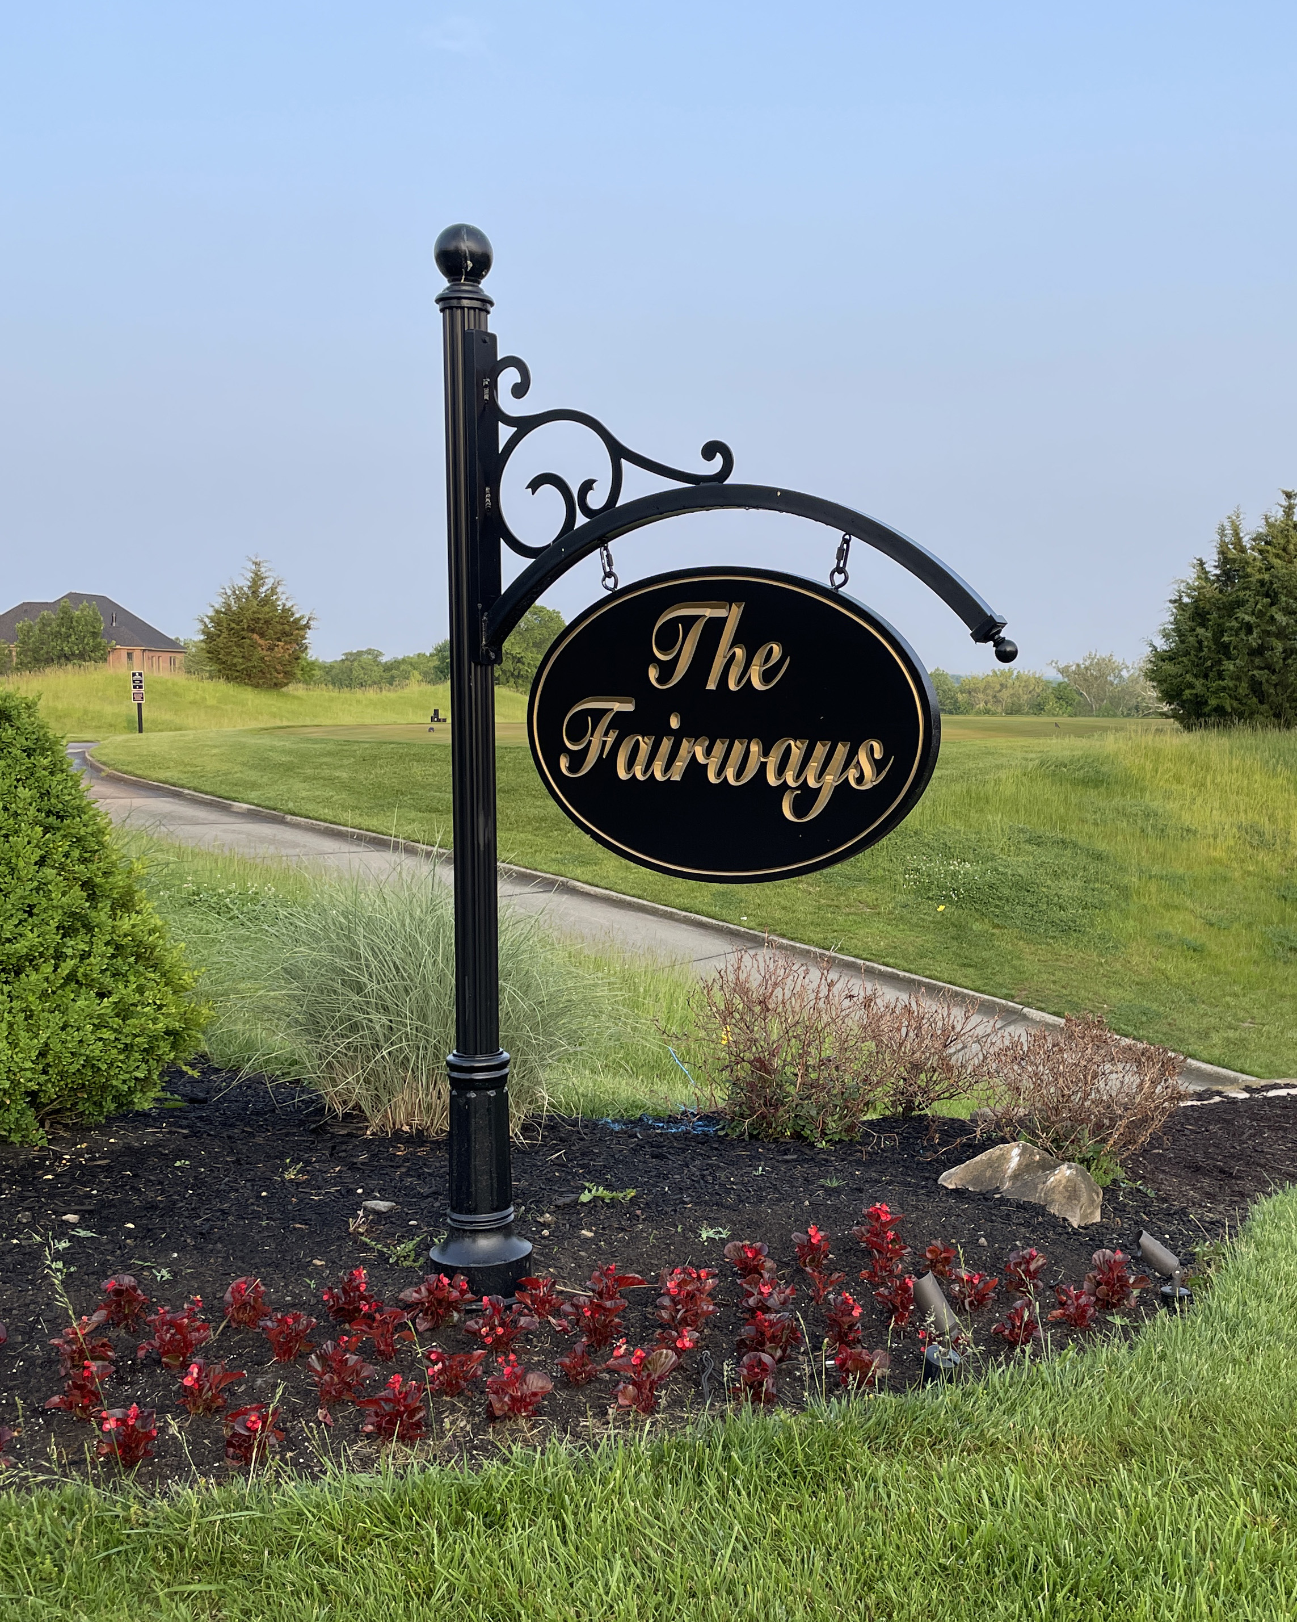
Call to Order
Call to Order
  Barbara Sourjohn, President
Second
  TBD

Slide 4
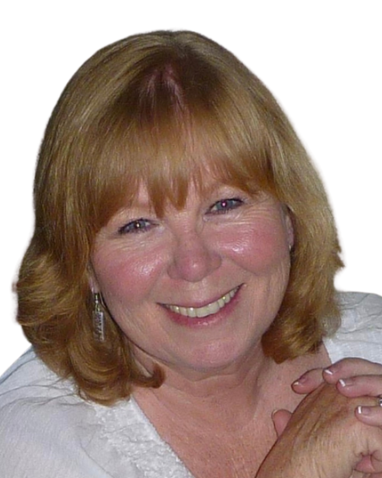
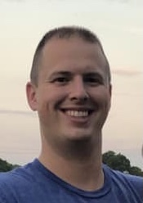
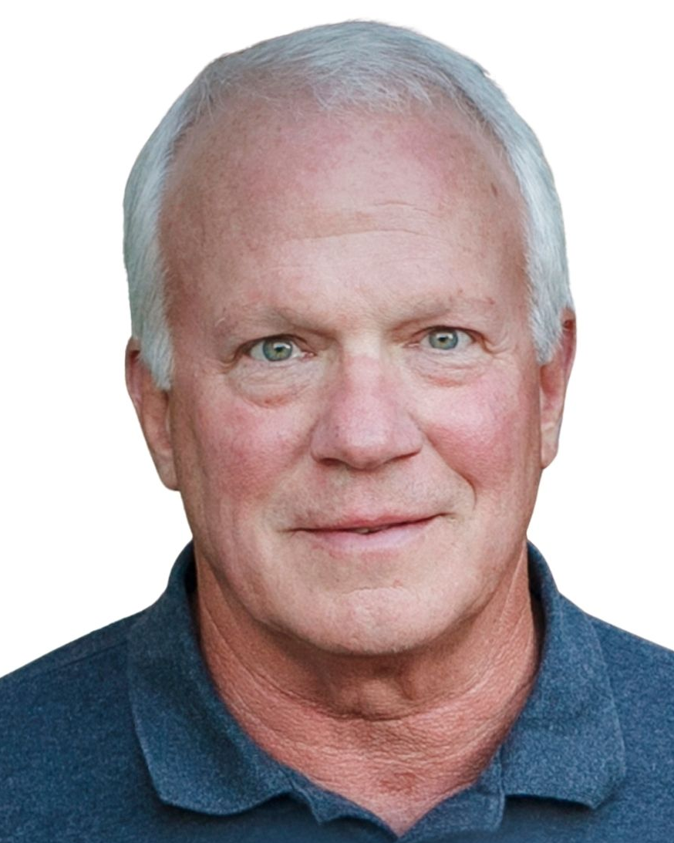
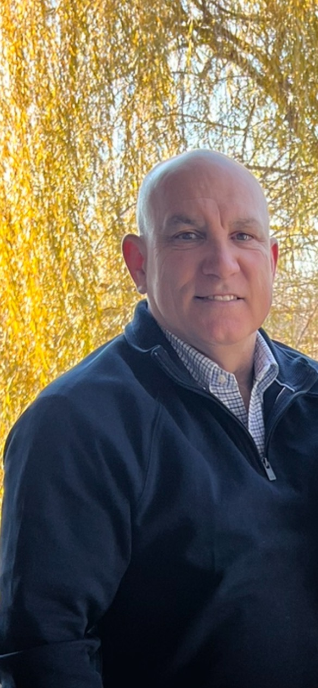
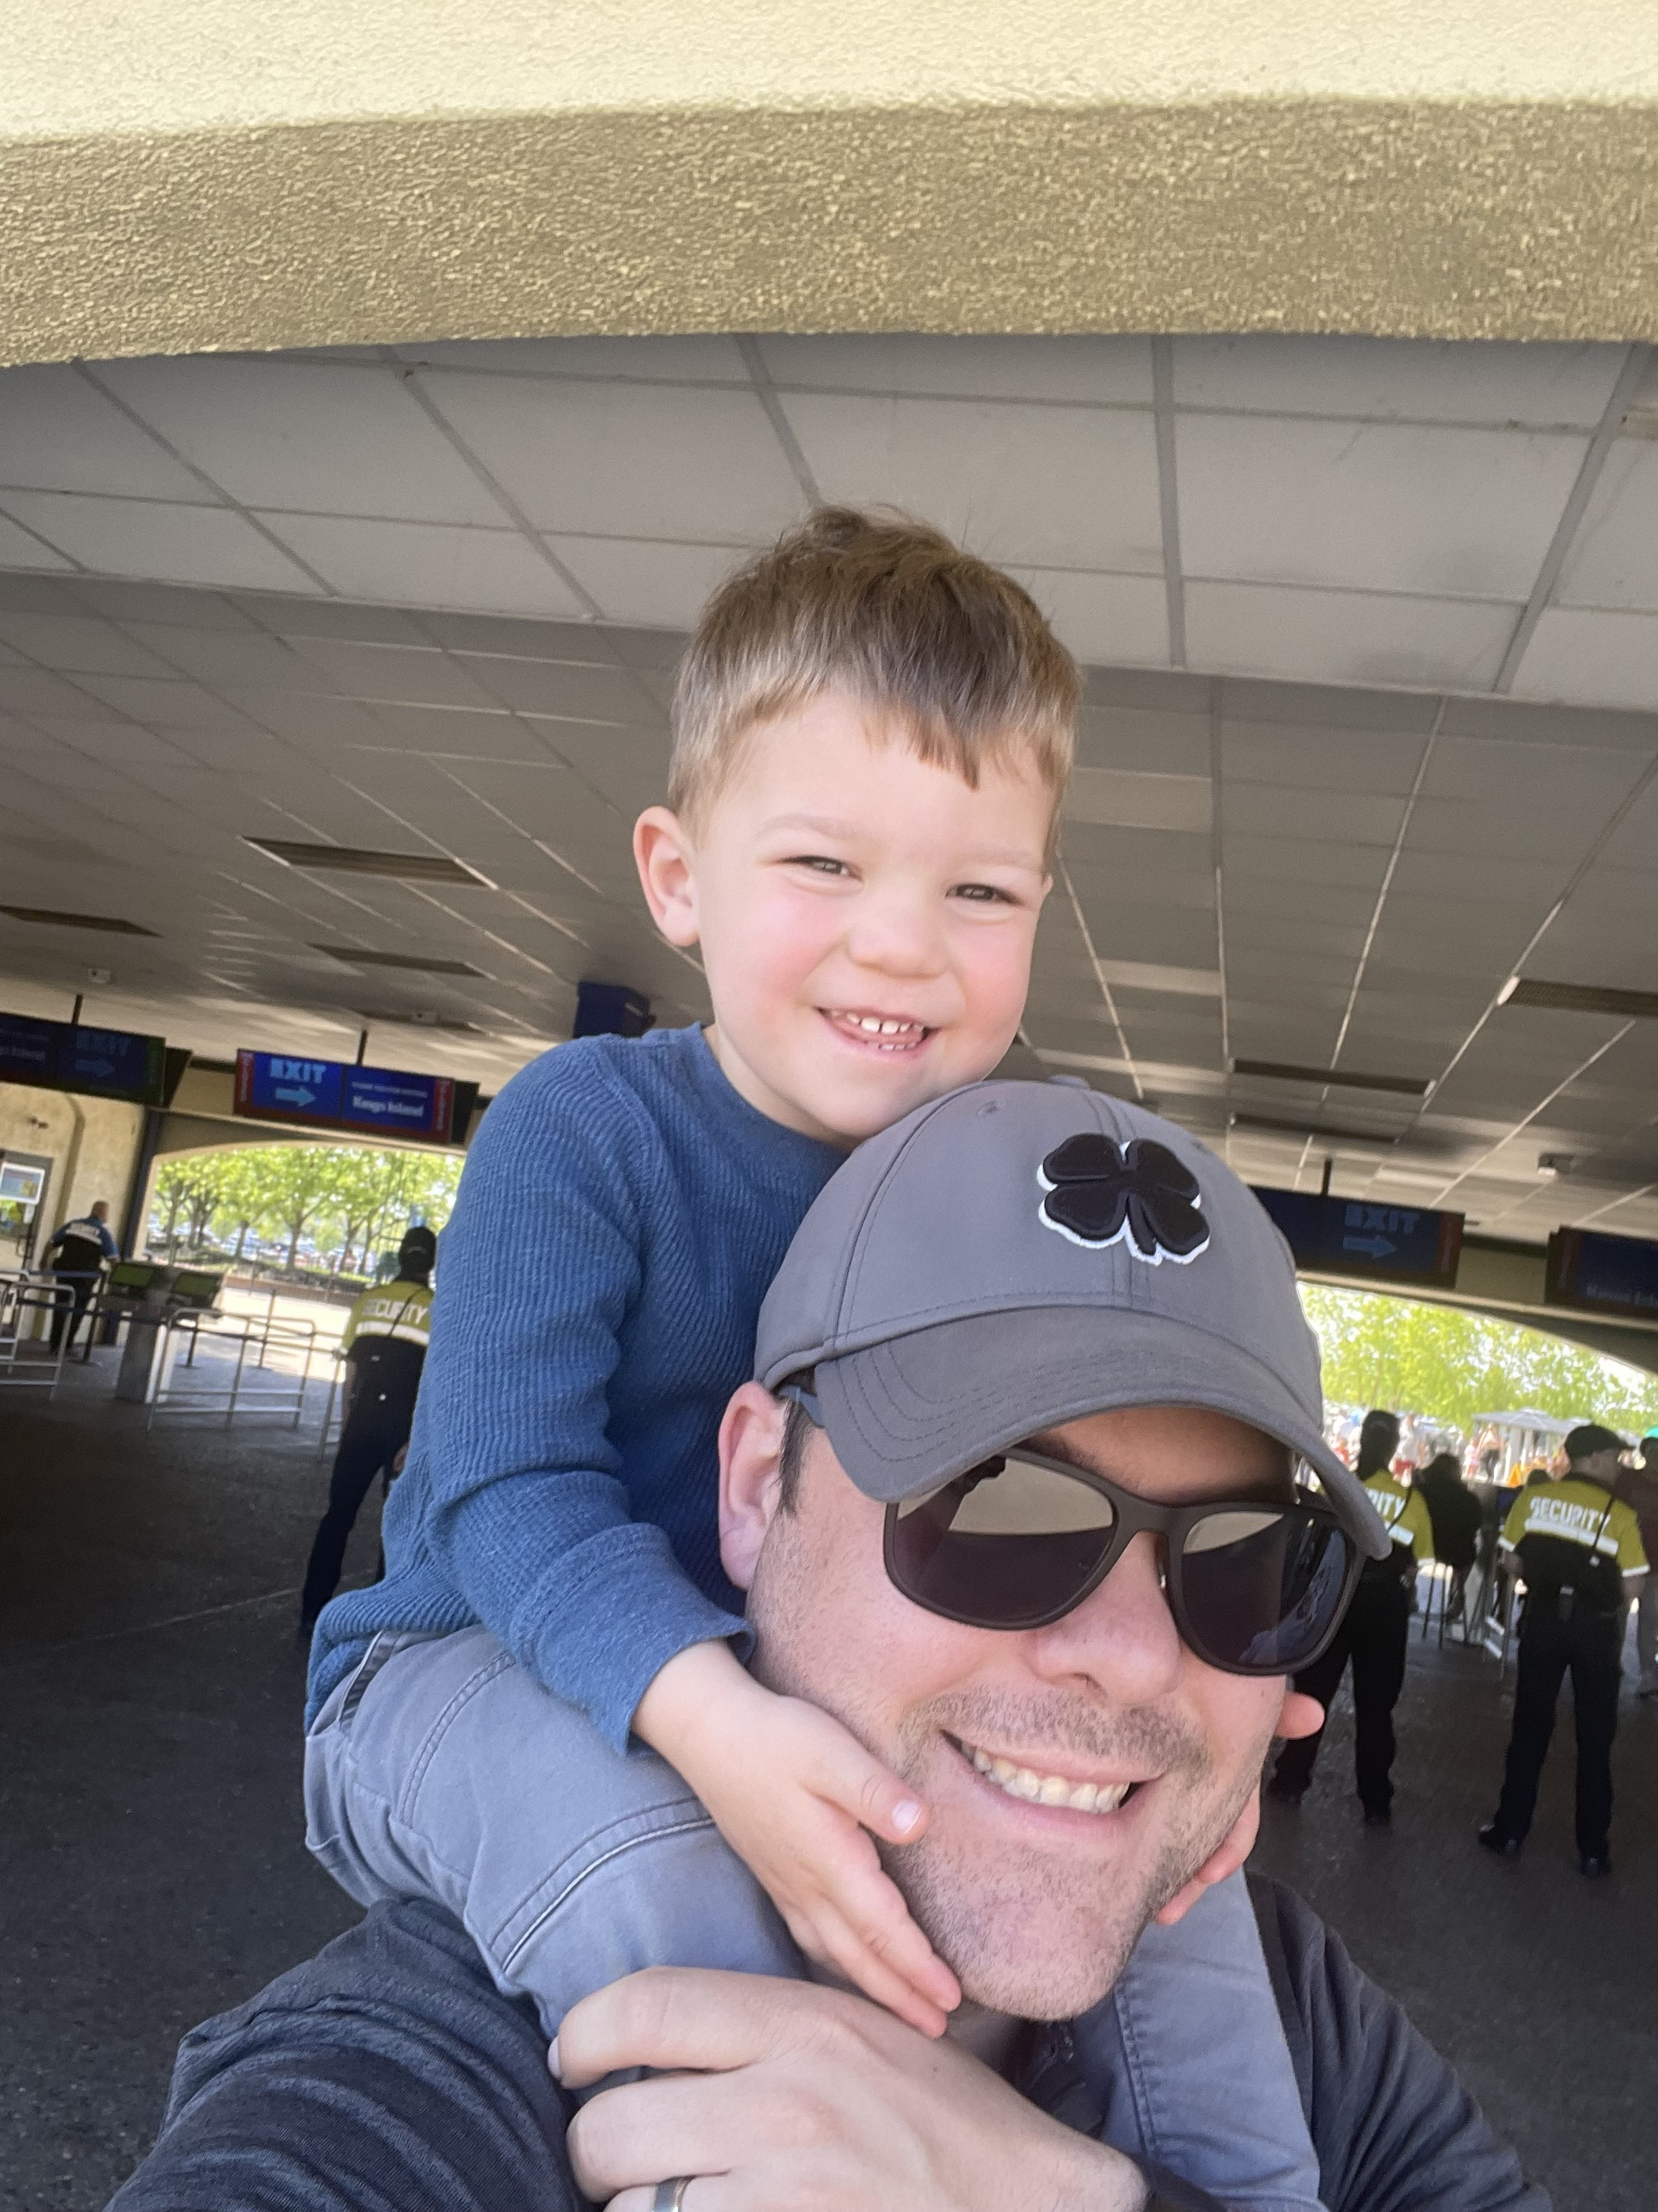
Intro to Board
Barbara Sourjohn, President
Nate Myers, Vice President
Harry Nieman, Treasurer
Chuck Schlie, Secretary
Scott Scheider, Member at Large

Slide 5

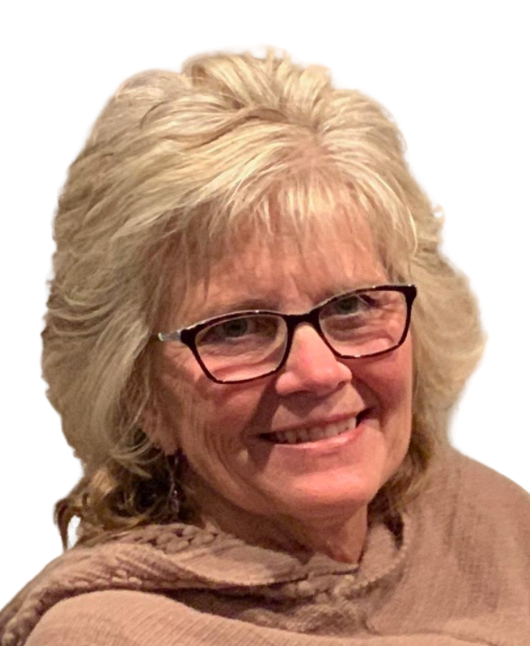
Intro HOA Service Provider
Gail Adams, Advantage Property Management
www.MyFairways.org

Slide 6
Intro to New Residents
New Residents June 2023– Present
  Last lot on Emerald View Drive
  411 Fox Chapel Run

Slide 7
2023 Meeting Minutes, Approval
Call for approval
  2nd by:

Slide 8
Special Guest – Brent Wilkins
MI Homes Land Acquisition Manager
Preliminary grading plan
Drainage plan updates
Current Layout
Questions

Slide 9
Special Guest –Darryl Cordrey
Hamilton Township Trustee
MI Homes Development
Hamilton Township Development
Questions

Slide 10
2023 Financial Update
2023 Budget 2023 Actual Variance
  Revenue $ 51,200 $ 50,026 ($1,173)
  Expenses $ 50,268 $ 49,668 $594
  Reserve $ 10,600 $ 10,600 -

Slide 11
2023 Financial Update
December 2023 – Balance Sheet
$22,848 Checking Account
$55,395 Reserve Account
Reserve Funding
  Accruing for future asset replacement / planned projects

Slide 12
2024 Financial Update
2024 Budget
  Revenue $ 51,200
  Expenses $ 51,200
  Reserve $ 6,224
New Expenses for 2024
  Electric control panel at pond
  Replacement pond fountain
  RB HOA cost sharing increase
  Drainage issues (improved grates)

Slide 13
MI Homes Development –
Fairways Community Goals
Fix drainage issue
Maintain / increase our home values – consistent with current home style, size, materials
Adhere to the Fairways CC&Rs
Solve safety issue at entrance
Join our HOA
  Document amendment required – 75% approval needed

Slide 14
Amending the Document
Needed to add MI Homes development to our HOA
Opportunity to clarify and update our document
Customize document to align with our community today

Slide 15
TPC Sportsplex
Barry Worrell, Fairways Rep
Tennis Courts
Pool
New Facilities Manager – Monica Weidman
Reminder – al fitness classes are included with your Sportsplex membership. No additional cost for classes. Please use SuperSAAS App to sign up for classes so the instructor will know how many to expect. This also helps the SP Committee monitor demand and make necessary changes.

Slide 16
Committee Updates
Social Committee
  Fairways Final Fridays in the works
Landscape Committee
  New members
    Nancy Freitch
    Kathy Guerin
    Special thanks to Peggy Neiman, Katie Gates and Amy Steimer
Interested in being involved?
  Contact any Fairways HOA Board Member

Slide 17
Reminders
Community Garage Sale
  May 17 & 18
  8:00am – 3:00pm
Changes to landscape or hardscape require approval
Pets – good neighbor rule – pick up after them and control barking

Slide 18
Election of Officers 2024-2026
Officers serve a 2-year term
Officers up for re-election:
  Member at Large
Up to 5 residents on HOA board
  Barbara Sourjohn, President
  Nate Myers, Vice President
  Harry Nieman, Treasurer
  Chuck Schlie, Secretary
  Scott Scheider, Member at Large

Slide 19
Adjournment
Motion to adjourn
  Barbara Sourjohn, President
Second?
  TBD

