Slide 1
The Fairways of River’s Glen
Annual HOA Meeting
May 3, 2022

Slide 2
Welcome Neighbors!
Agenda
Call to order
Intro to HOA Board
Intro to HOA Service Provider
Intro New Residents
2021 Meeting Minutes, 2021 Review
2022 Financial Update
TPC Sportsplex
Future Projects
Election of Officers, 2022-2023
Open Discussion
Adjournment

Slide 3
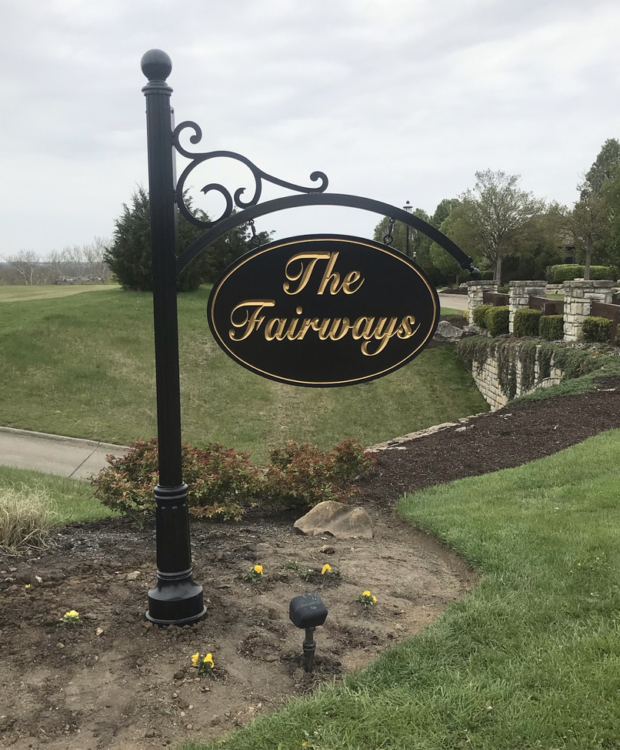
Call to Order
Call to Order
  Barbara Sourjohn, President
Second
  TBD

Slide 4
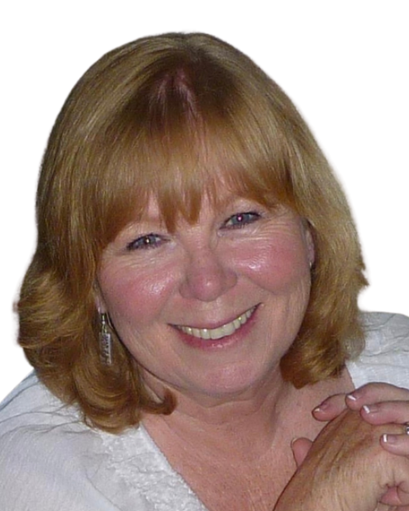
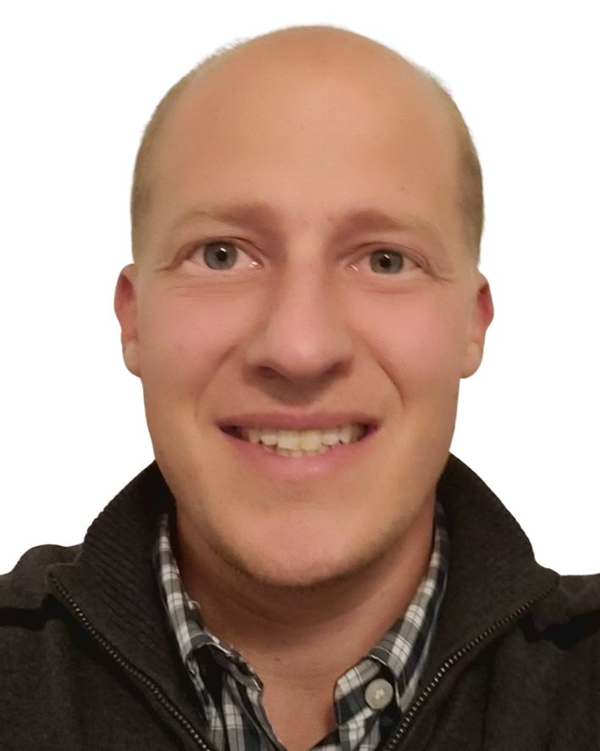
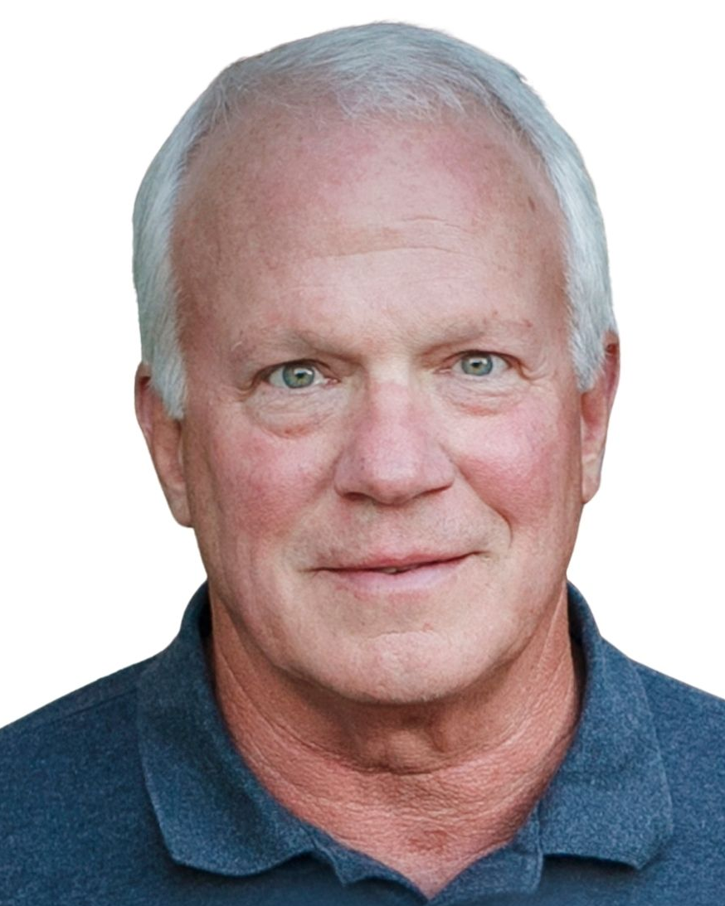
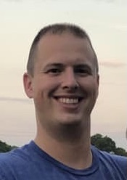
Intro to Board
Barbara Sourjohn, President
Erick Meutsch, Vice President
Harry Nieman, Treasurer
Nathan Myers, Secretary

Slide 5

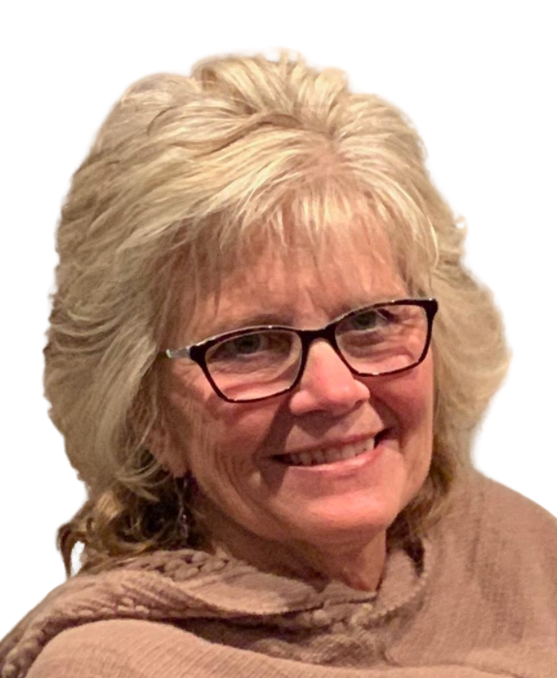
Intro HOA Service Provider
Gail Adams, Advantage Property Management
www.MyFairways.org

Slide 6
Intro to New Residents
New Residents March ‘21 – Present
  5123 Emerald View Drive
  5124 Emerald View Drive
  5238 Emerald View Drive
  5250 Emerald View Drive
  5256 Emerald View Drive
  5267 Emerald View Drive (pending)
  446 Glen Abbey Ln (pending)
  452 Glen Abbey Ln
  418 Fox Chapel Run
  436 Fox Chapel Run (pending)
  Lot 45B Fox Chapel Run (new construction)

Slide 7
2021 Meeting Minutes, Review
Copies provided here
Call for approval
  Second?
2021 Review
  Waterfall
  New sign
  Tree removal / replacement at pond

Slide 8
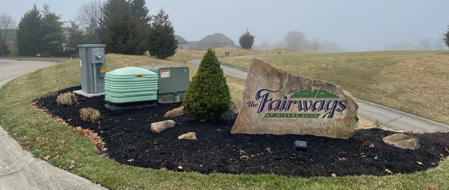
New Signage

Slide 9
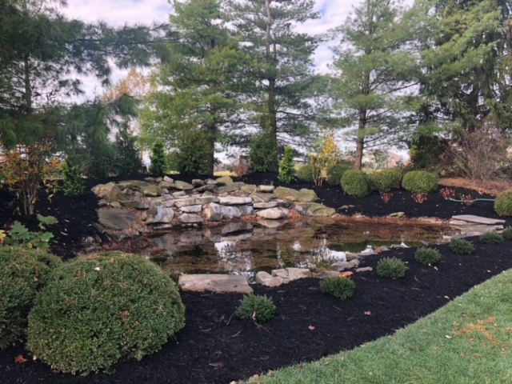
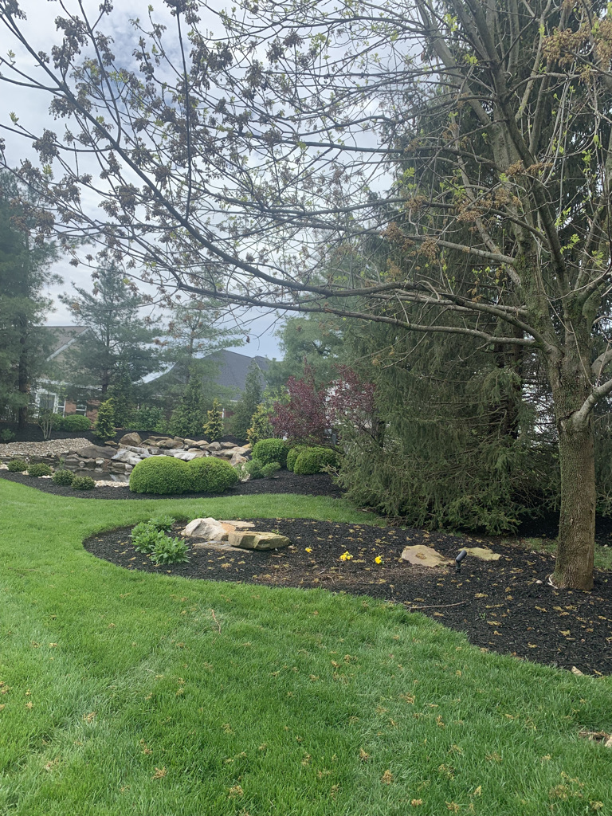
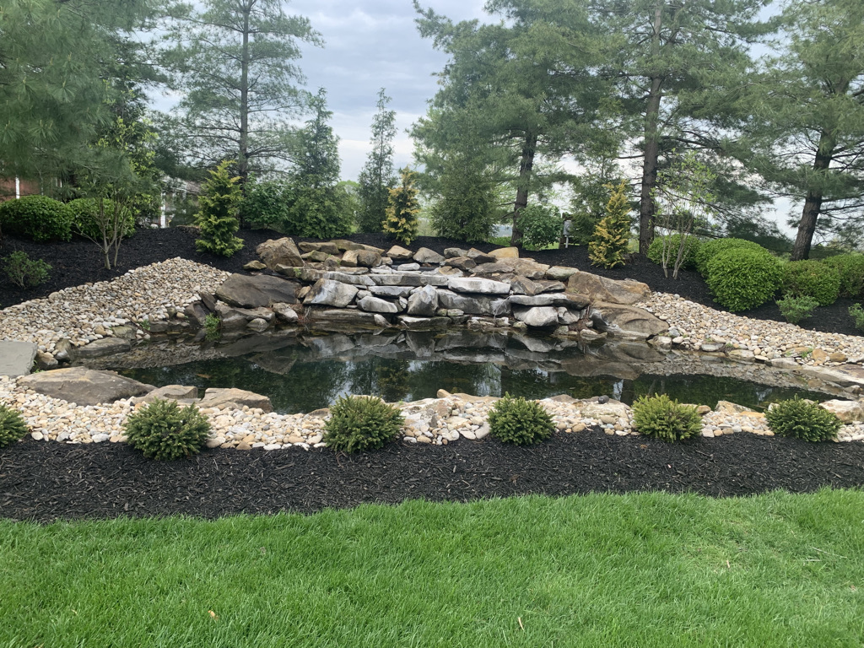

Waterfall rocks and cleanup

Slide 10
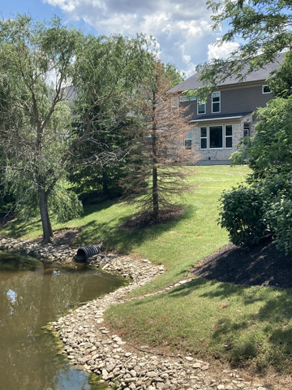
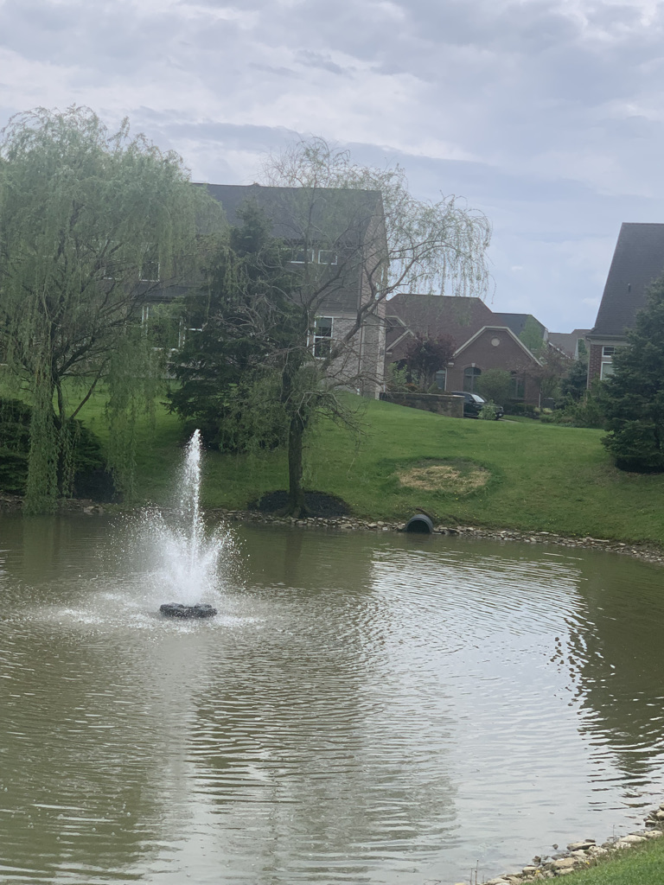




Tree removal and replacement at pond

Slide 11
2021 Financial Update
2021 Budget
  Revenue $45,675
  Expenses $31,035
  Reserve $14,640
New Expenses for 2021
  Sign (50% of cost)
  Holiday lights
December 2021
$24,296 Checking Account
$51,455 Reserve Account

Slide 12
2022 Financial Update
2022 Budget
  Revenue $46,400
  Expenses $33,335
  Reserve $13,065
New Expenses for 2022
  Sign (50% of cost)
  Beehive grates
May 2022
$49,389 Checking Account
$63,194 Reserve Account

Slide 13
TPC Sportsplex
Tennis Courts
  Need water remediation – fall 2022
Pool
  Repairs – valve replacement and concrete and drain repair
  Opens May 28, Memorial weekend, 11-9 daily through August 17. Reduced hours after 8/17
  Pavilion available for rent evenings from 5-9. $100 / one family only / max 40 persons
  Chairs all re-strapped
Ice Machine
  Primary purpose is safety – no cooler filling
Opening Celebration
  Saturday evening, June 4. Food trucks, games, face painting
July 4th Parade
Barry Worrell, Fairways Rep
Bathroom renovation
  New toilets, cabinets, sinks
  Repainted
  Locker painting & some removed to add dressing room
HVAC
  One of four original furnace units being replaced
Weight Equipment
  New weight rack and Smith
Cardio Equipment
  Complete purchase and replace bike and treadmills
Pickle Ball Courts
  One new court

Slide 14
Short Term Rentals – Amendment Discussion
Limitation on Short Term Rentals
  No shorter than 12 months
  No short-term rentals
    (i.e. Airbnb, VRBO, etc.)
  Amendment Requires Vote
    Committee desired to research and recommend
Open Discussion

Slide 15
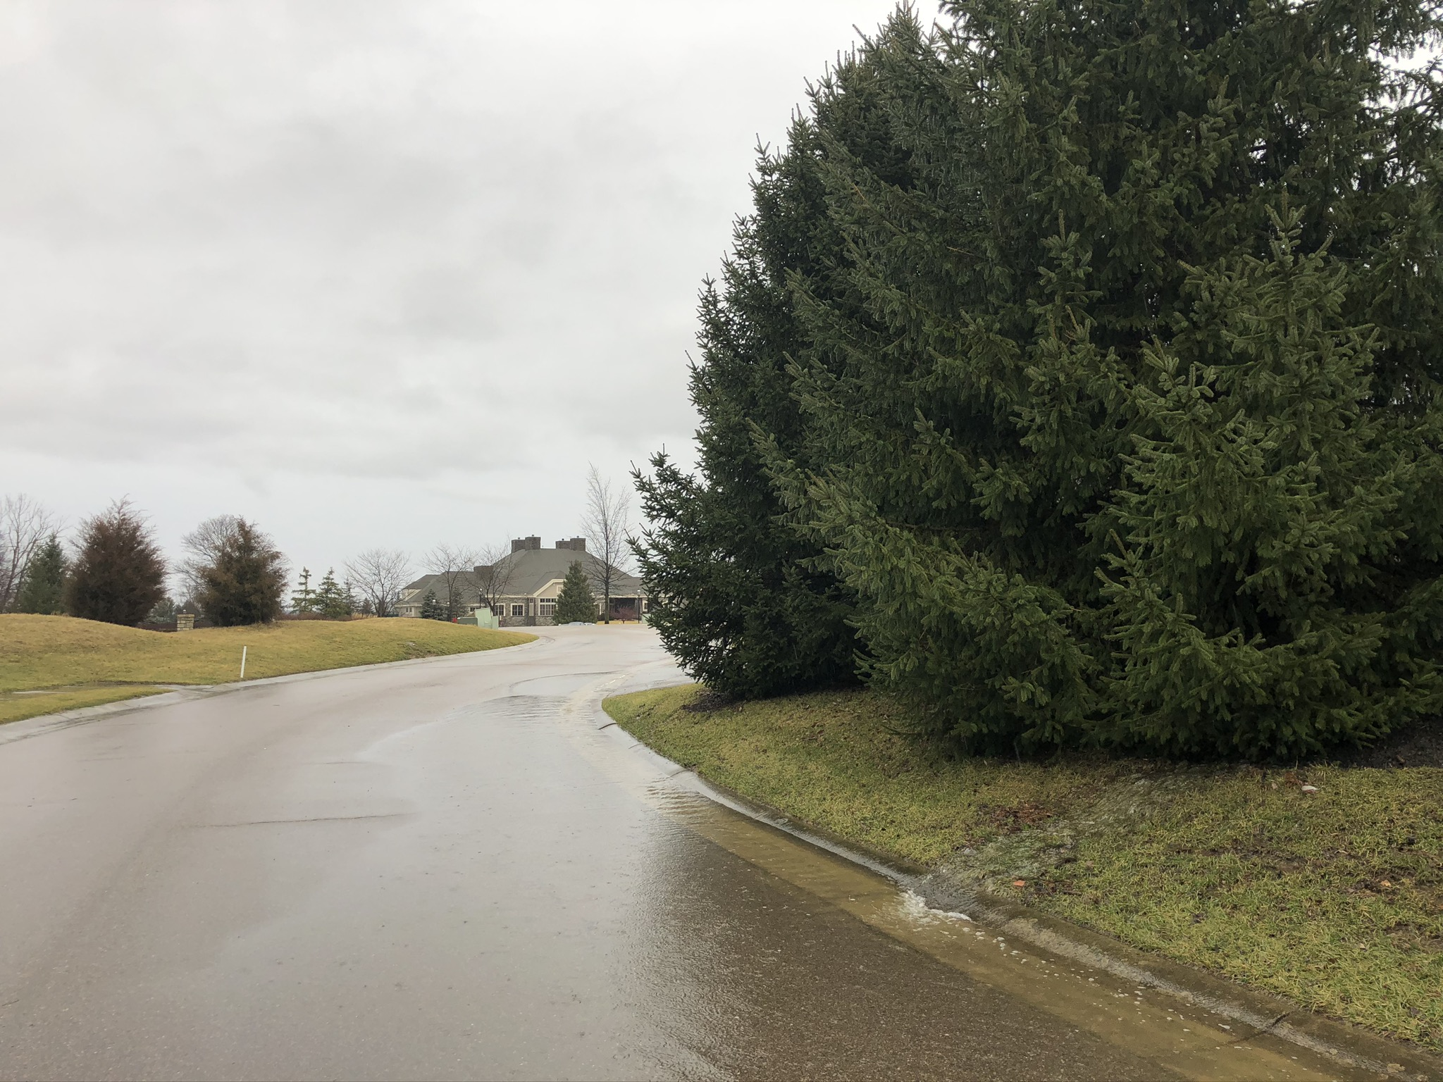
Safety
Fairways Blvd
  Blind Curve
  Parking
  Emergency vehicles MUST be able to drive through the street
  You are responsible for your guests’ parking
Speed
  Maximum 25 MPH

Slide 16
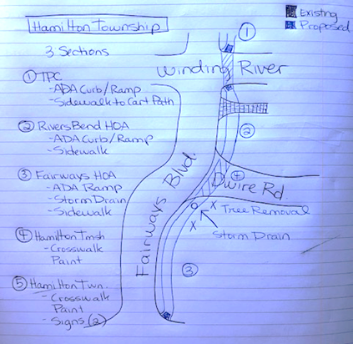
Future Projects
Crosswalks & Sidewalks
  $2,860 TPC
  $4,125 River’s Bend HOA
  $9,855 Fairways HOA*
    *Plus $3000 Tree Removal & Replacement
    = $12,855 Fairways HOA
    (all pricing subject to updated bids)
Fairways Water Flow Issues

Slide 17
Social Committee
Social Committee
  Fairways Final Fridays
  Open House
  Socials at the Club
Interested in being involved? Leading a social committee?
  Contact any Fairways HOA Board Member

Slide 18
Election of Officers 2022-2023
Officers serve a 2 year term
Officers up for re-election:
  Barbara Sourjohn, President
  Harry Nieman, Treasurer
  Nathan Myers, Secretary
Up 5 residents on HOA board
  President
  Vice President
  Treasurer
  Secretary
  Board Member
?

Slide 19
Adjournment
Motion to adjourn
  Barbara Sourjohn, President
Second?
  TBD

