Slide 1
The Fairways of River’s Glen
Annual HOA Meeting
June 8, 2023

Slide 2
Welcome Neighbors!
Agenda
Call to order
Introductions
2022 Meeting Minutes & 2022 Review
2022 & 2023 Financial Update
Activity Review
Zoning Issue
Short Term Rentals
Social Committee
Safety
TPC Sportsplex
Election of Officers, 2023-2024
Open Discussion
Adjournment

Slide 3
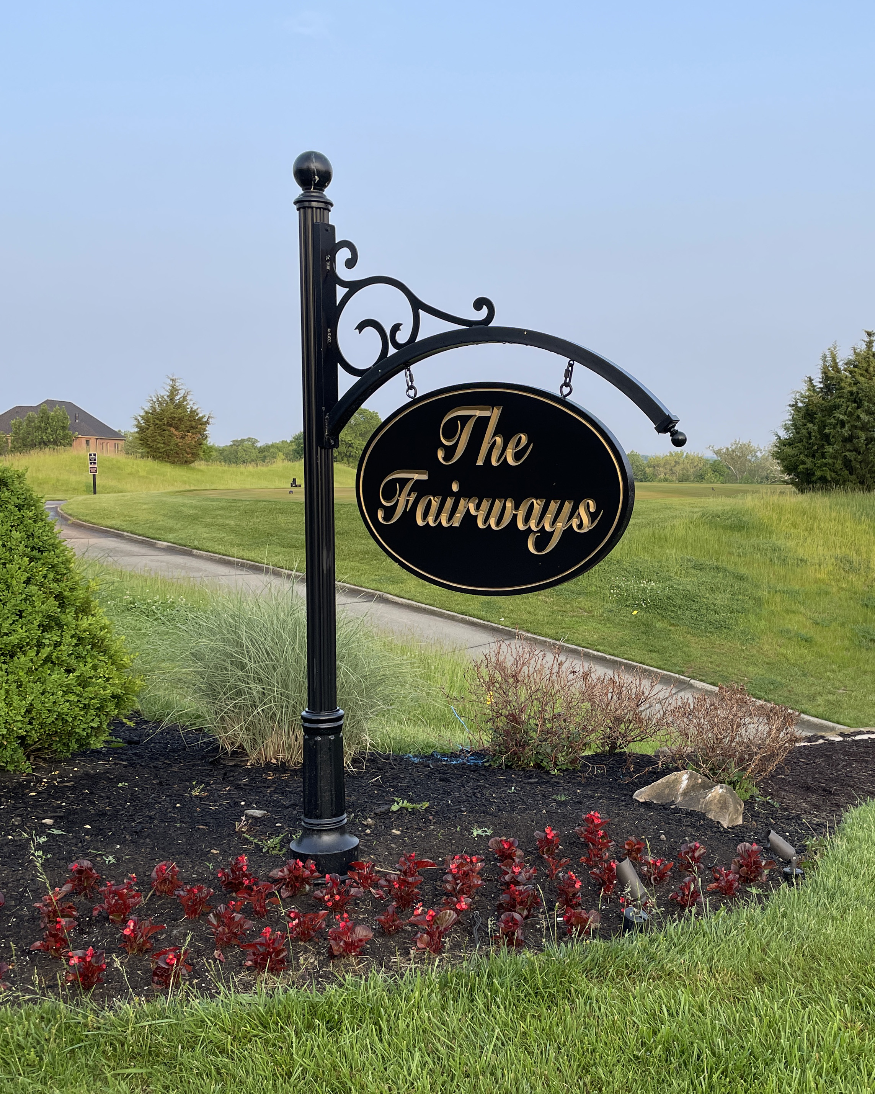
Call to Order
Call to Order
  Barbara Sourjohn, President
Second
  TBD

Slide 4
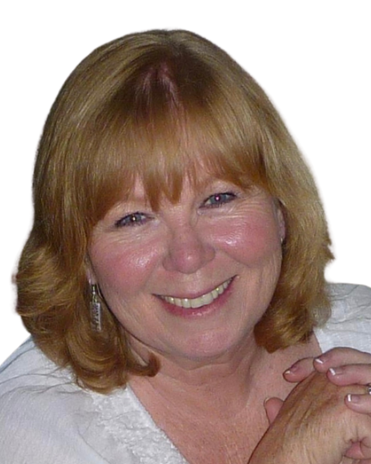
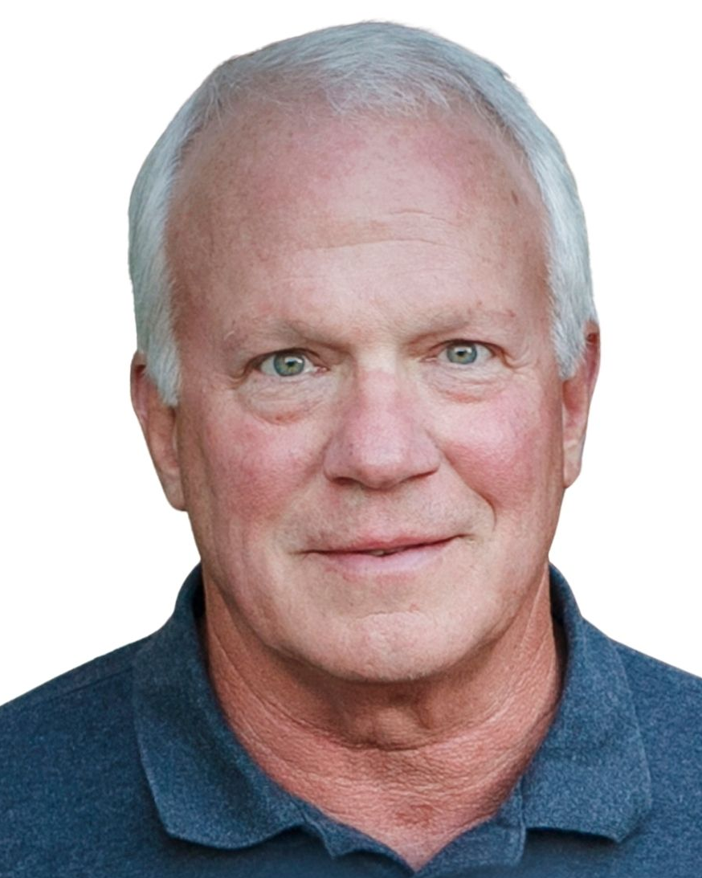
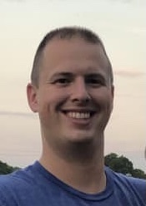
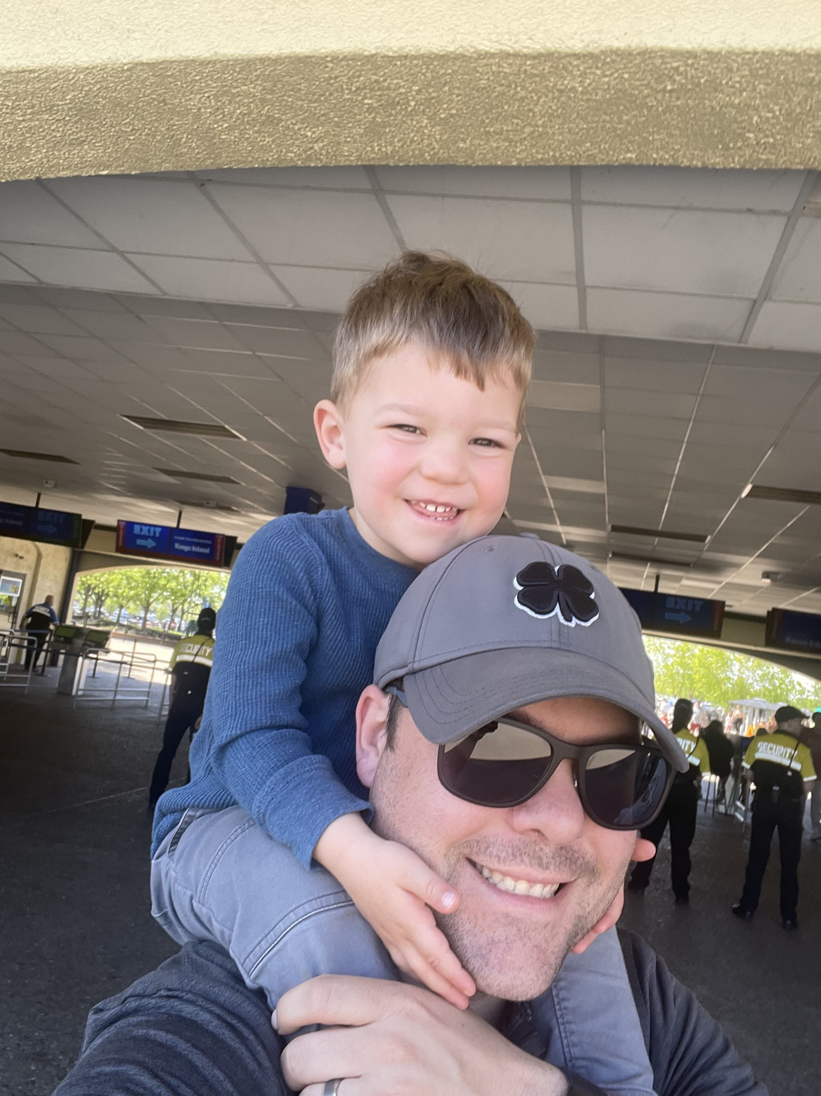
Intro to Board
Barbara Sourjohn, President
Vice President
Harry Nieman, Treasurer
Nathan Myers, Secretary
Scott Scheider, Member at Large

Slide 5

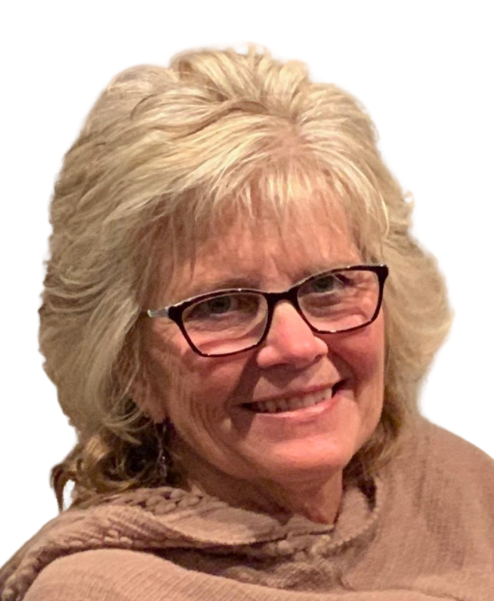
Intro HOA Service Provider
Gail Adams, Advantage Property Management
www.MyFairways.org

Slide 6
Intro to New Residents
New Residents May ‘22 – Present
  5123 Emerald View Drive
  5160 Emerald View Drive
  5267 Emerald View Drive
  446 Glen Abbey Ln
  429 Fox Chapel Run
  436 Fox Chapel Run

Slide 7
2022 Meeting Minutes, Review
Copies provided prior to meeting
2022 Review
  Streetlights
  Waterfall
  Pond pump and electric box
  Tree removal / replacement at pond

Slide 8
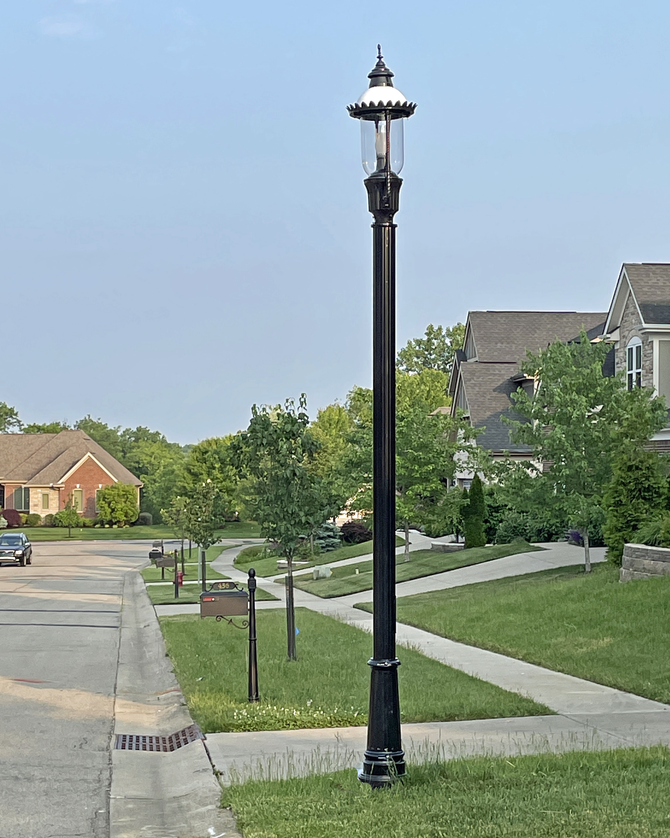
Additional Streetlights
Fox Chapel Run
Emerald View

Slide 9
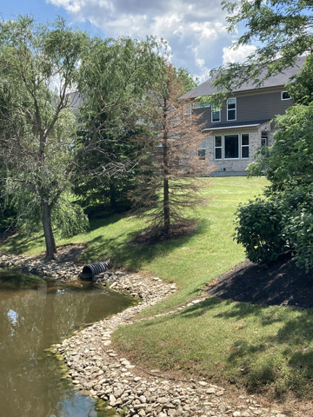
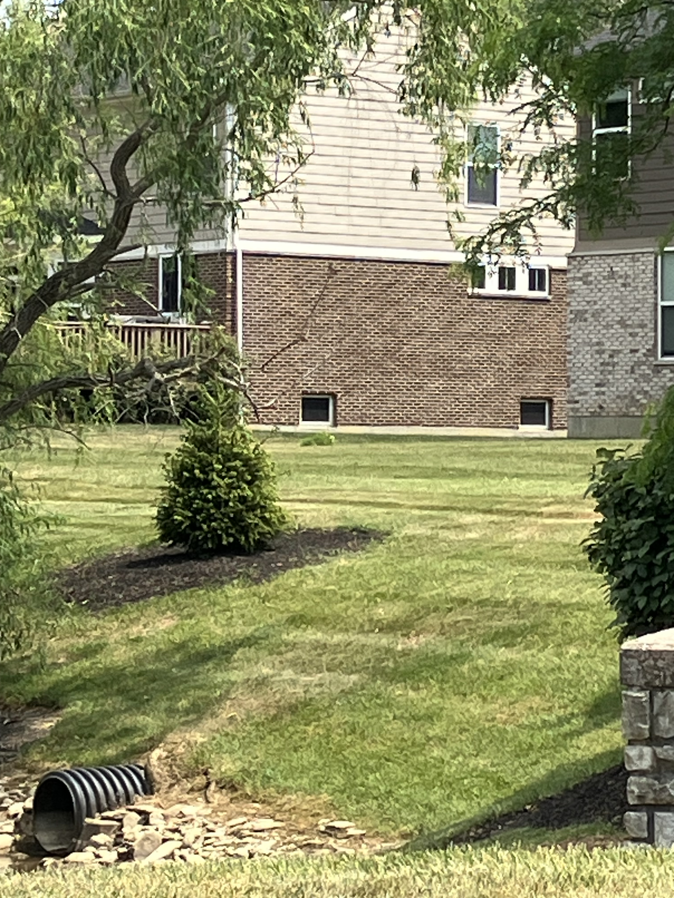


Tree removal and replacement at pond

Slide 10
2022 Financial Update
2022 Budget 2022 Actual Variance
  Revenue $ 45,675 $ 45,655 ($ 745)
  Expenses $ 46,000 $ 48115 $2,115
  Reserve $ 13,065 $ 13,065 -

Slide 11
2022 Financial Update
December 2022 – Balance Sheet
$22,163 Checking Account
$63,460 Reserve Account
Reserve Funding
  Accruing for future asset replacement / planned projects

Slide 12
2022 Meeting Minutes, Approval
Call for approval
  2nd by:

Slide 13
2023 Financial Update
2023 Budget
  Revenue $ 51,200
  Expenses $ 40,600
  Reserve $ 10,600 (reduced contribution vs 2022)
New Expenses for 2023 – 10% dues increase / general cost increases everywhere
  Streetlights ($9,500 from reserve account)
  Electric control panel at pond
  Replacement pond fountain
  RB HOA cost sharing increase
  Drainage issues (improved grates)

Slide 14
Drainage
Never perfect from the beginning
As homeowners we own the problem
Modified grates for marginal forgiveness where possible
Pay attention to debris accumulation / removal
HOA memory bank for future development

Slide 15
2022 Activity Review
Board service activities – 14 requests
  Architectural Review Committee
    Landscape???
    Hardscape (roof, paint, etc.)????
    Other????
  Concerns
    Pets
      Good neighbor rule (pick up after walking dogs, barking, etc.)
  TPC Walking paths issue – safety issues / enforcement?

Slide 16
RB Zoning Issue
10 acres at entrance requested zoning change from residential to commercial
Strong support for change by S. Lebanon City Council and Mayor
Positive outcome

Slide 17
Short Term Rentals – Update
Limitation on Short Term Rentals
  No shorter than 12 months
  No short-term rentals
    (i.e. Airbnb, VRBO, etc.)
  Amendment Requires Vote
    Committee desired to research and recommend
Open Discussion

Slide 18
Social Committee
Social Committee
  Fairways Final Fridays
  Open House
  Socials at the Club
Interested in being involved? Leading a social committee?
  Contact any Fairways HOA Board Member

Slide 19
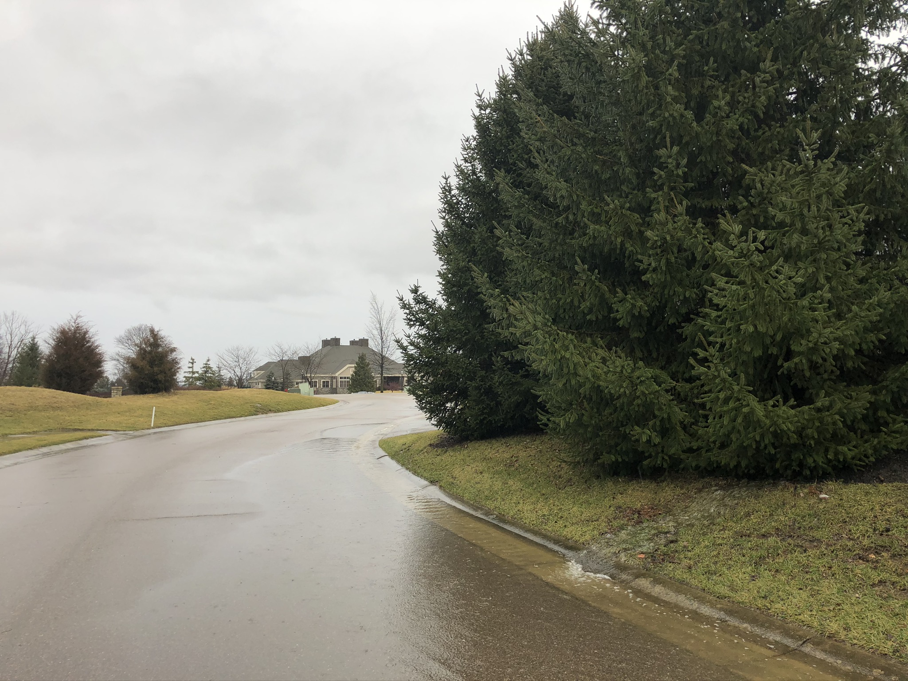
Safety
Fairways Blvd
  Flock camera
  Blind curve
    Tree removal and replacement

Slide 20
TPC Sportsplex
Tennis Courts
  Still working on solutions. Repair is not a option due to soil beneath the courts.
  Large equipment access is challenging and may be cost prohibitive.
  No chages planned for 2023.
Pool & Pavilion
  Opened May 26, - 11-8 daily through August 13. Reduced hours after 8/13
  10 guests per member.
  Pavilion available for rent evenings from 4-8. $100 / one family only / max 40 persons
  No rentals on holidays (Memorial Day, July 4th, Labor Day)
  Contact JenniferSamaniego@TowneProperties.com for reservations.
July 4th Parade
Barry Worrell, Fairways Rep
Cardio Equipment
  Planning on replacing two treadmills this summer
Fitness Classes
  Updated summer class schedule
  Pleased to offer water aerobics three times per week
  Monica will convert her Tuesday morning Abs and Assets class to a 9:45am water aerobics class.
  All other classes remain the same
Reminder – al fitness classes are included with your Sportsplex membership. No additional cost for classes. Please use SuperSAAS App to sign up for classes so the instructor will know how many to epect. This also helps the SP Committee monitor demand and make necessary changes.

Slide 21
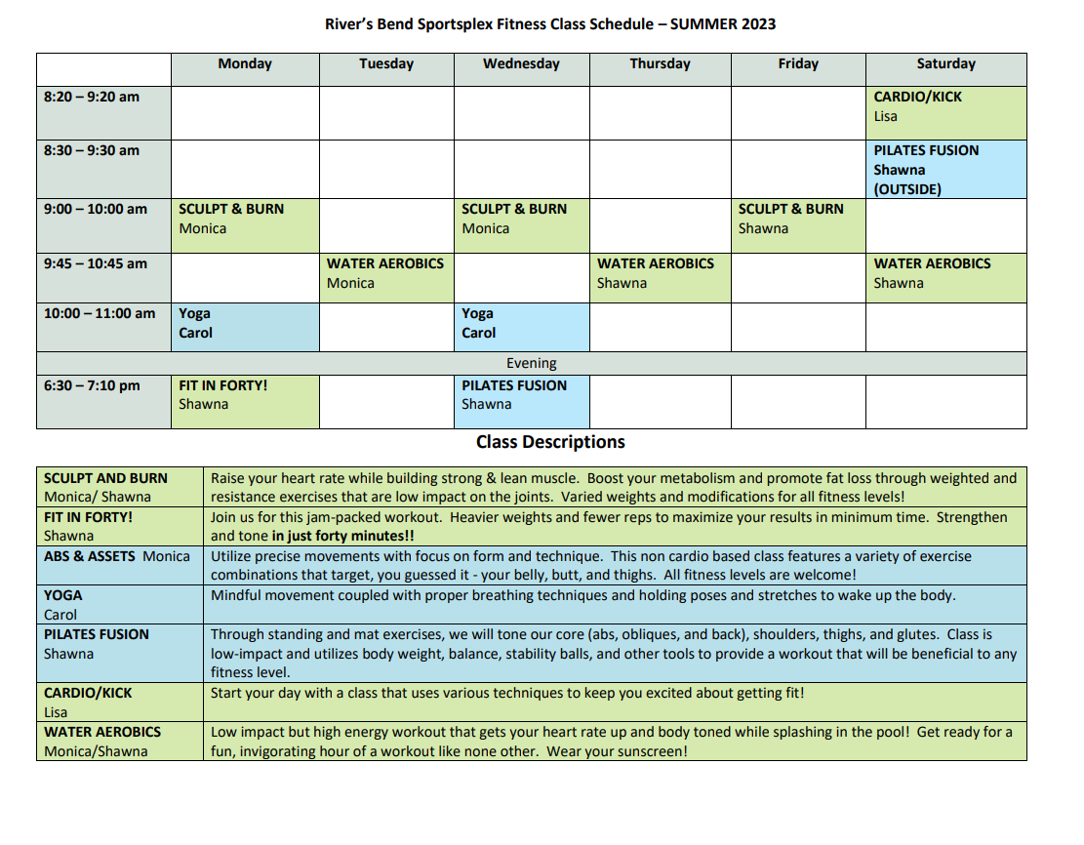

Slide 22
Election of Officers 2023-2024
Officers serve a 2-year term
Officers up for re-election:
  Vice President
Up 5 residents on HOA board
  Barbara Sourjohn, President
  Vice President
  Harry Nieman, Treasurer
  Nathan Myers, Secretary
  Scott Scheider, Board Member
?

Slide 23
Adjournment
Motion to adjourn
  Barbara Sourjohn, President
Second?
  TBD

